Slide 1
November 2016
Board of Directors Meeting

Slide 2
Nominating Committee: Board Elections
Corporate Nominations for Existing Board Seats (3):
Douglas Fisher, ExxonMobil (Term ends 12/2019)
Piyush Bhargava, Dell (Term ends 12/2018)
Nedra Dickson, Accenture (Term ends 12/2017)
Corporate Re-nominations for Existing Board Seats (Term Ending Dec 2019):
AT&T Alithia Bruinton
Avis Budget Group Lynn Boccio
Bank of America Barbara Kubicki-Hicks
Ford Motor Company Renee Jones
Johnson & Johnson Beverly Jennings
KPMG LLP Barbara Carbone
ManpowerGroup Nancy Creuziger
Microsoft Corporation Fernando Hernandez
Motorola Solutions Lisa Stenglein
Pitney Bowes Inc. Laura Taylor
Robert Half Kathleen Trimble
UPS Estrella Cramer
Note: The ExxonMobil Global Services Company seat is also expiring this year. Douglas Fisher (above) is recommended to succeed Linda Sexton for this term.
Confidential

Slide 3
Nominating Committee: Board Elections
Current Open Corporate Board Seats (3):
  Office Depot/Office Max
  Chevron
  Energy Future Holdings
Current Corporate Seats Available (1):
  Altria has relinquished their seat
Forum Nominations to Board (Term ending December 2019):
  Cheryl Snead: Banneker Industries (Re-nomination)
  Patricia Rodriguez-Christian: CRC Group, Inc. (Re-nomination)
  Cathi Coan: Techway Services, Inc.
Leadership Council Nominations to Board (Term ending December 2019):
  Roz Lewis: Greater Women’s Business Council (Re-nomination)
  Michelle Richards: Great Lakes Women’s Business Council (Re-nomination)
  April Day: Women’s Business Enterprise Alliance
Confidential

Slide 4
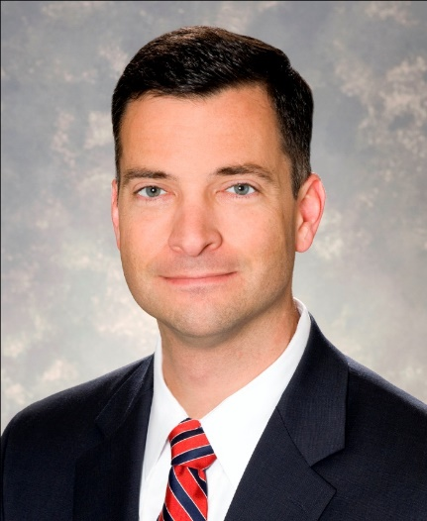
Corporate Seat Replacement – Renee Jones
Nominating Committee: Corporate Nominations
    ExxonMobil
    Term ending December, 2019
Responsible for Procurement’ global safety, controls, planning, training, bidding centers, analytics, sourcing & acquisition processes as well as supplier diversity, local content and sustainability
Began career with ExxonMobil in 1990
Has held various positions including International Purchasing Advisor, Procurement Supervisor for the Houston Production Organization, Global Local Content Manager, Chemical Acquisitions Manager, Planning and Reporting Manager, Equipment & Materials Sourcing Manager & Chemical Procurement Manager
Douglas Fisher
Strategic Procurement Manager
Confidential

Slide 5
Corporate Seat Replacement – Julie Cooke
Nominating Committee: Corporate Nominations
    Dell, Inc.
    Term ending December, 2018
Currently leads a global organization responsible for procurement and partner management of Dell’s Human Capital, Customer Facing Services, Human Resource Services, Technology, Real Estate and Marketing products and services.
With Dell for over 17 years. Has managed strategic sourcing of various high spend commodities
Previously held various management positions at Intel, General Motors and Siemens.
Piyush Bhargava
Vice President, Indirect Procurement & Packaging
Confidential

Slide 6
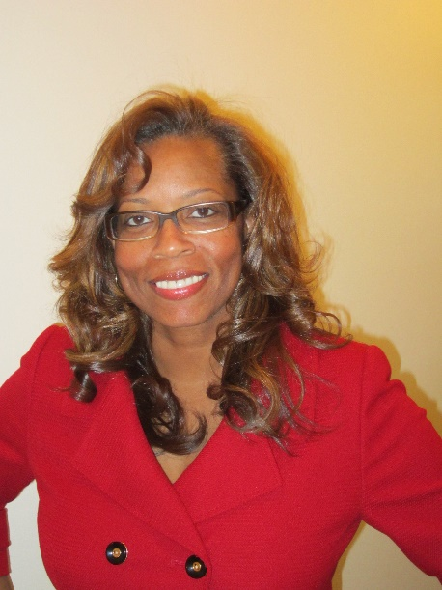
Corporate Seat Replacement – Renee Jones
Nominating Committee: Corporate Nominations
    Accenture
    Term ending December, 2017
Responsible for leading and promoting Accenture’s well-established efforts to maximize procurement opportunities with diverse businesses as suppliers and subcontractors within 16 countries.
Has grown Accenture’s Diverse Supplier Development Program (DSDP) in four geographies (US, Canada, UKI & South Africa).
Large range of experience including Technology Support, Delivery Center Implementations, SAP Development, Operations Management, Customer Service and Sourcing and Category Management.
Nedra Dickson
Global Supplier Diversity and Sustainability Lead
Confidential

Slide 7
Nominating Committee: Board Demographics by Gender

Slide 8
Nominating Committee: Board Demographics by Race

Slide 9
Nominating Committee: Board Demographics by State

Slide 10
Nominating Committee: Board Demographics by Industry

Slide 11
Resolution to Approve Current Candidate Slate
  “As Chair of the Nominating Committee, on behalf of the entire Committee, I move for a Vote to Approve the Recommended Slate of Board Candidates.”
                - Clint Grimes

Slide 12
WBENC Board Resolution

Slide 13
Questions?
Thank You

Slide 14

2017 Activities: Overview
2017 WBENC Anniversary Logo

Slide 15
2017 WBENC Summit & Salute
New Orleans, LA
Event Planning Kickoff Overview
Extract for the EEC

Slide 16


Overarching Theme: “Reflection & Vision”
Although we will begin celebrating/promoting the WBENC 20th Anniversary in January and throughout the entire year, Summit & Salute will be the official kickoff event in 2017.
We want to certainly reflect on the past 20 years that brought us to where we are today, but also recognize the present and visualize our future.
The 2017 Summit & Salute schedule will be more robust than years past.
We will officially recognize Tuesday March 21st as Day One.

Slide 17



WEDNESDAY Lunch – Stars Celebratory Luncheon
This will be the first official general session to KICKOFF Summit & Salute!!!
We will be honoring and recognizing the past 20 years of Stars.
This will be incorporated into our programming and décor.
Where are they now? (Video clips?)
Class of xxxx (2005, 2010, 2015, etc)

Slide 18
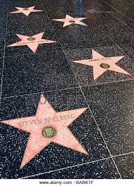
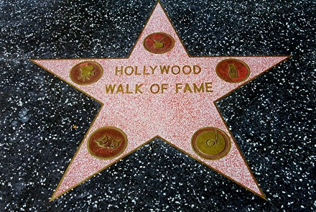
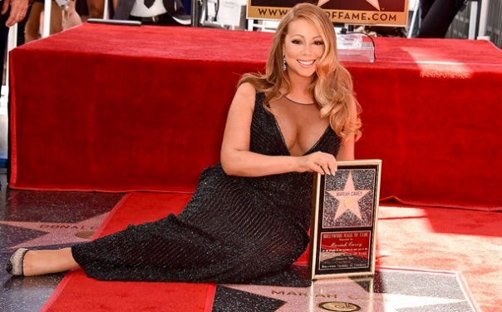
WEDNESDAY Welcome Reception:
*Question – Focus of Welcome Reception:
Is the intention for the Wednesday Welcome Reception to focus on the Women of Distinction?
Or will we continue honoring the Stars as well?
WBENC “Walk of Fame”
(Potentially Stars and Women of Distinction?)
Inspired by Hollywood’s walk of fame
Honoring our “stars”
Purple stars instead of red
This can somehow double as a plaque/award/takeaway for the honorees
Creates lots of photo opportunities
Perhaps we create a separate area for the Women of Distinction and a separate area for Past Stars
FYI – 20 out of the 25 Women of Distinction are past WBE Stars
*Question - Silent Auction:
Will we be sticking to the normal auction format and offer only Power Meetings with Top Corp Executives? Or will we be offering some physical items as well this year to make things different for the 20th anniversary?
The stars have different icons on them representing which “area” of Hollywood the entertainer is recognized in. This is something that we could essentially do to recognize more individuals throughout our network during the 20th anniversary – and technically not just limit it to the Stars/WOD (WBEs)…
Perhaps the “Walk of Fame” can be a “museum/exhibit” on display in a common area for attendees to observe on their way to and from various sessions throughout the remainder of event.

Slide 19










THURSDAY: General Session Lunch & Keynote Speaker
Stage will need sponsor logos as we will have a Keynote Luncheon Sponsor. Perhaps built in screens/lighting that can change based on the different Top Corp distinction that is being recognized.
Recognizing America’s
Top Corporations
This general session will be the only time when we will have a keynote speaker at the event.
We will want to book
ONE AMAZING speaker!!
Possibly a member of the Shark Tank cast? Or another well-known exciting household name!!
On Thursday we will be focusing on the Top Corporations – so the “star” elements from Wednesday will need to be replaced – we have bronze, silver, gold and platinum levels of Top Corps. Perhaps we could recognize Bronze and Silver at Lunch – and Gold and Platinum at Salute Dinner.

Slide 20
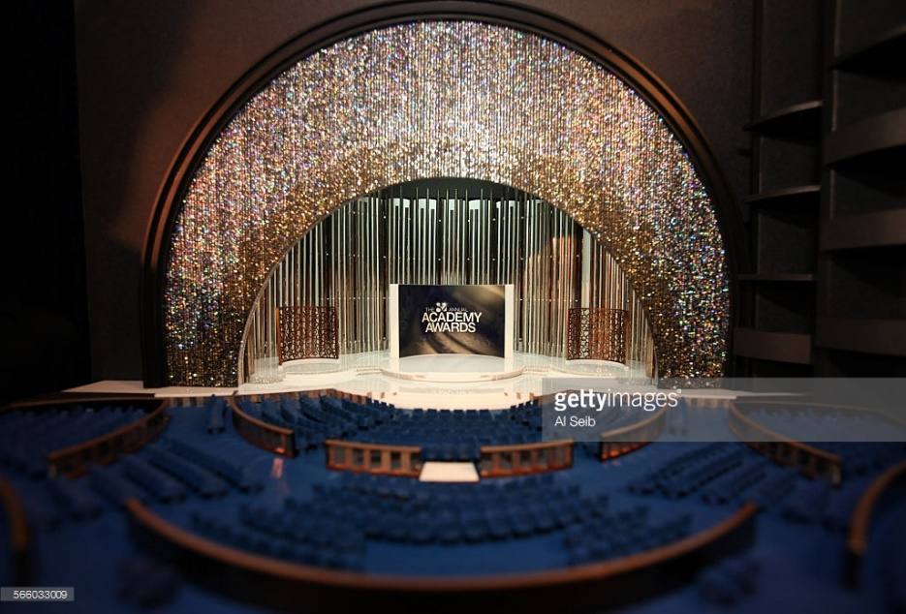







THURSDAY: Salute Dinner
“The Oscars” theme
Tribute Dinner at NCBF will be themed around “The Grammy’s” – all about music, fun, concert, high energy, etc.
Salute Dinner at S&S could compliment that by theming it around the “The Oscars” – Hollywood’s biggest/most prestigious night, elegant, extravagant, red carpet, step & repeat, media/paparazzi, honoring the “WBENC celebrities”
We could have a host/MC for the evening similar to Neil Patrick Harris/Ellen/etc.
Awards show programming, bring different “presenters” up to the stage, “Best Actress”, “Best Supporting Actor” could translate into categories within 20th anniversary recognition
Play lots of video clips to highlight key moments/accomplishments like they do for movies at the Oscars

Slide 21


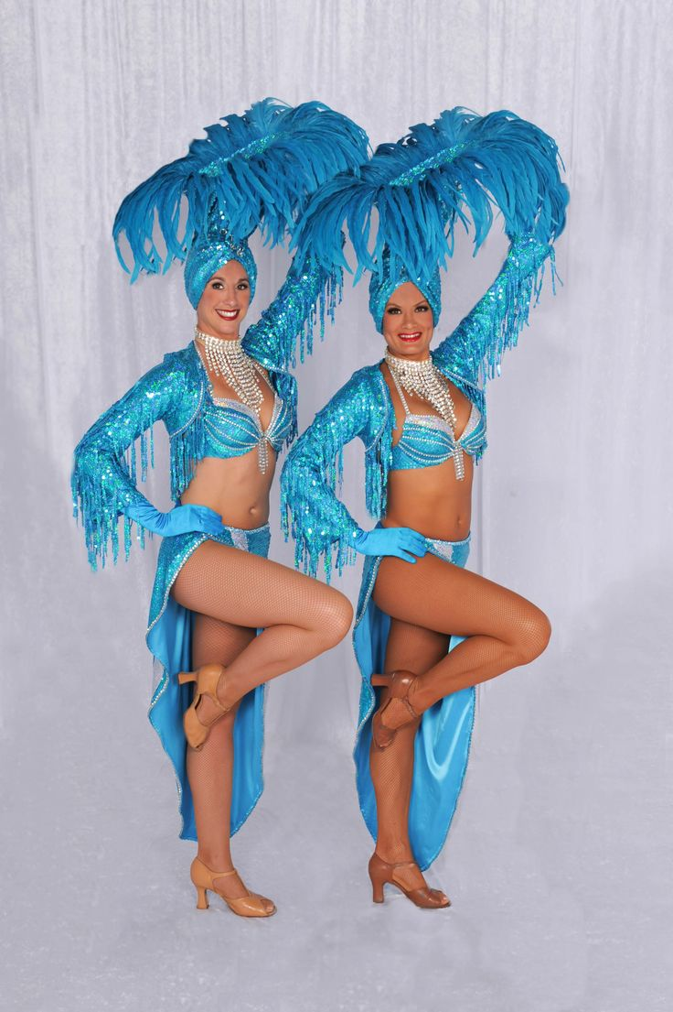



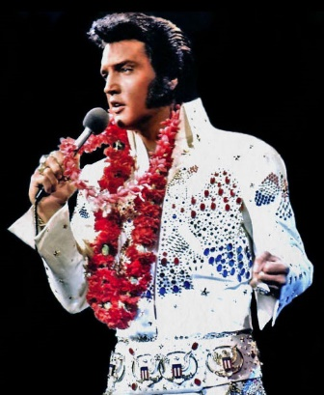
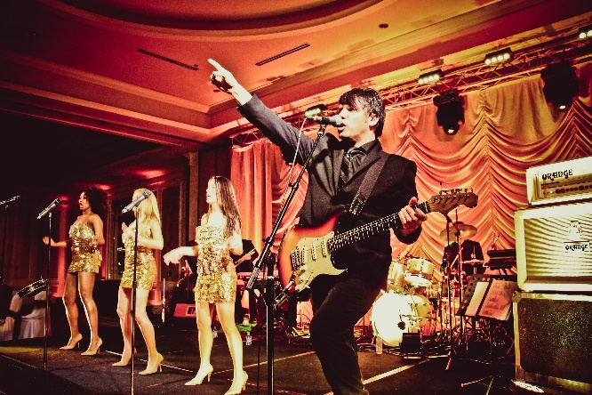



Photo op for guests with 1-2 showgirls in purple & teal WBENC colored
costumes
THURSDAY AFTERPARTY: “VEGAS BOUND”
Las Vegas themed party favors:
hats, glasses, noise makers, confetti
Signature WBENC
Vegas Cocktail
Michael Jackson and/or Elvis impersonator
High energy live band!
Black Jack tables, possibly WBENC branded poker chips

Slide 22
2017 WBENC National
Conference & Business Fair
Las Vegas, NV
Event Planning Kickoff Overview –
Extract for EEC

Slide 23



Overarching Theme: Looking Back. To The Future.
We are take a quick moment to reflect on the incredible 20 year journey of this organization and then setting our sights on the exciting future that lays ahead.
The main focus is on the Future and what is to come, while still paying appropriate homage to the past.

Slide 24

Tuesday Theme – The Wonder Women of WBENC
Use the day to highlight the incredible and fierce women who make up WBENC. Pay homage to the past and the excitement and hope of the future.

Slide 25



The Beach Party
Consider doing a live auction from the stage
Have branded pool floats in the water
Create a signature drink – The Amazon Princess
Give out Sandals of Hermes flip flops
Determine if there are other appropriate giveaways such as the indestructible bracelets

Slide 26
Wednesday Theme - TBD
?
TBD
Need to book exceptional speaker.
Note: If we book an exceptional speaker (e.g. Oprah or Ellen) we can then ask a Corporate Member to specifically sponsor that speaker.
ExxonMobil will be a Business Fair Luncheon Sponsor and will be spearheading something for the Hes4Shes, likely a video that we can link to with the Zapper.

Slide 27



Thursday Theme – Michael Jackson: Defining a Generation
Michael Jackson’s music defined a generation of pop culture while our WBEs defined a generation of women’s business owners.
Suggested Luncheon Keynote: Suzanne de Passe – Legendary Motown Producer: Executive producer of the series Sister, Sister and Smart Guy, Emmy Award winner Suzanne de Passe began her career bringing in The Jackson 5.
Tribute Dinner will be The WBENC Awards, modeled after the Grammy Awards. It will be a night of celebration recognition, red carpets, glitz and glamour.
Incorporate the Michael Jackson One performers into the day. Ideally host them for dinner, but if not incorporate into lunch.

Slide 28

#Hes4Shes Awards – The People’s Choice Awards
Open nominations for the #Hes4Shes People’s Choice Awards.
  During the Summit & Salute open for nominations/vote from the Forum only.
  Reveal “Top 10” #Hes4Shes and open voting for the People’s Choice during the National Conference & Business Fair.
  Announce the winning #Hes4Shes during the Tribute dinner.

Slide 29
Treasurer’s Report to
Board of Directors
2016 Financial Overview and
2017 Recommended Budget
November 16, 2016

Slide 30
Purpose of Presentation
  YTD October 2016 Financial Results & 2016 Forecast
  2015 Audit & 2015 Form 990
  Review the 2017 Recommended Budget

Slide 31
2016 Full Year Forecast
Revenue, Expenses and Net Income
YE revenue projected to be $10,919k against original 2016 budget of $10,632k
Increased attendance and dual location requirements (S&S) drove increased expenses to budget
Remain committed to meet / exceed $182k Budgeted Net Income

Slide 32
2016 Financial Progress
  Balance Sheet as of October 31, 2016
  Cash - $3.8M
  Net Liquid Current Assets - $4.3M (Cash + Accounts Receivable – Accounts Payable/Accrued Expenses)
    $617k improvement over 10/31/15
  Net Working Capital - $3.5M (Current Assets – Current Liabilities)
    $309k improvement over 10/31/15
  Accounts Receivable - $715k
    $157k higher than 10/31/15

Slide 33
2015 Audit & 2015 Form 990
  2015 Audit
  Received a Clean/Unqualified Opinion
  Net Income of $195k
  2015 Form 990
  No Changes
  Governance
    Audit Committee & WBENC Staff met with audit partner. This satisfies the IRS requirement for board review.
  Best Practices
    Whistleblower, Conflict of Interest, and Retention & Destruction Policies are in place though not required by the IRS
  Performance Metrics
    Management/General + Fundraising Expenses against Total Expenses 15% (17% in 2014)
    Management/General + Fundraising Expenses against Revenue 15% (16.5% in 2014)
    Common benchmark under 25%

Slide 34
2017 Budget
Revenue, Expenses and Net Income
Budgeted revenue of $11,575k in 2017, representing a 6% increase vs. 2016 forecast
Expenses budget of $11,575k, representing an 8% increase vs. 2016 forecast
Balance budget due to investment in 20th Anniversary Activities

Slide 35
2017 Budget: Revenue
Summary by Revenue Category
Revenue (including In-Kind) | 2017 Budget | 2016 Forecast | 2016 Budget
Membership | $4,288,000 | $4,133,000 | $4,000,000
Sponsorship | $4,640,000 | $4,231,000 | $4,095,000
Contributions | $85,000 | $149,000 | $71,000
Registration Fees | $1,667,000 | $1,532,000 | $1,504,000
Exhibit Fees | $650,000 | $653,000 | $750,000
Other | $245,000 | $221,000 | $212,000
Total Revenue | $11,575,000 | $10,919,000 | $10,632,000
Budget Increase 6%
Notes:
% changes for major categories:
Membership – 4% increase from 2016 forecast to 2017 budget. Formulation based upon full year dues (detail on the membership assumptions next slide)
Sponsorship - 10% increase from 2016 forecast to 2017 budget. Detail sponsorship information will be covered in the next two slides.
Contributions - comprised of the IBM in-kind agreement related to Tuck. A decrease from 2016 forecast due to a one time contribution from Wells Fargo.
Registration Fees – 9% increase from 2016 forecast to 2017 budget. This is a stretch goal. We expect to meet this goal based on the locations: New Orleans and Las Vegas.
Exhibit Fees – remain flat. Our sponsorship success has decreased exhibit fees because NCBF Sponsorships include a booth.
Other Income – comprised of auction revenue ($200k) and recertification fees ($45k)

Slide 36
2017 Budget: Revenue
Membership Assumptions
Membership Revenue Brackets | Annual Membership Dues | Members | 2017 Dues Full Year
$70B + | $31,000 | 34 | $1,054,000
$35B - $69.9B | $26,000 | 27 | $702,000
$25B - $34.9B | $21,000 | 13 | $273,000
$13B - $24.9B | $16,000 | 41 | $656,000
$6B - $12.9B | $10,500 | 56 | $588,000
$1B - $5.9B | $8,500 | 83 | $705,500
< $1B | $6,500 | 27 | $175,500
Gov’t Agencies/Nonprofits | $2,500 | 20 | $50,000
 |  | 301 | $4,204,000
 | 2% Planned Growth |  | $84,000
 | Total Membership |  | $4,288,000
Key assumption:
2017 Membership Budget based upon 2% growth (5% growth and 3% unplanned attrition)
Notes:
The 2017 budget is based on 301 members (as of September 2016), plus a 5% planned growth and a 3% unplanned attrition.
Successfully recruited 40 new members this year.
As of November 2, we have 303 Members (includes New & Rejoined Members)
New members present sponsorship opportunities.

Slide 37
2017 Budget: Revenue
Sponsorships
Sponsorships | 2017 Budget | 2016 Forecast | 2016 Budget
Summit & Salute | $1,168,000 | $914,000 | $850,000
NCBF | $2,900,000 | $2,593,000 | $2,550,000
In-Kind Media | $300,000 | $459,000 | $400,000
Silent Auction | $0 | $0 | $0
Tuck | $112,000 | $174,000 | $180,000
Student Mentor/Other | $160,000 | $91,000 | $115,000
Total Sponsorships | $4,640,000 | $4,231,000 | $4,095,000
Budget Increase 11%
Notes:
NEW - 2017 Sponsorship Brochure
Comprehensive listing of all sponsorship opportunities to celebrate 20 years!
Offering more branding opportunities, e.g. commemorative gifts.
Calculated sponsorship revenue assumptions using a similar method as the membership revenue assumptions.
Summit & Salute – 28% increase from 2016 forecast to 2017 budget. Total restructuring sponsorship packages and the addition of new branding opportunities to include new branding opportunities e.g. charging station and entertainment.
National Conference & Business Fair – 12% increase from 2016 forecast to 2017 budget. Popularity of venture and new branding opportunities, e.g. flip flop (sandals).
Student Entrepreneur Program/ other income – 2017 budget SEP $135k (in-kind $10K) and annual report $25k.

Slide 38
2017 Budget:
Top Seven Expense Categories
Expense Category | 2017 Budget | 2016 Forecast | 2016 Budget
Events | $4,716,000 | $4,431,000 | $3,948,000
Staff Costs (salary, benefits, PR tax) | $3,279,000 | $2,997,000 | $3,051,000
RPO Allocations | $1,844,000 | $1,704,000 | $1,704,000
Professional fees & outside services Temporary Help ($25,000) Technology Fees ($318,000) Other Professional Fees ($294,000) Legal & Audit Fees ($112,000) | $749,000 | $650,000 | $726,000
Occupancy | $325,000 | $325,000 | $371,000
Staff Travel | $211,000 | $197,000 | $178,000
Depreciation & Administrative | $205,000 | $220,000 | $255,000
Other Remaining Expenses Total | $246,000 $11,575,000 | $213,000 $10,737,000 | $217,000 10,450,000
Notes:
% changes for major categories:
Events – 6% increase from 2016 forecast to 2017 budget. With new sponsorships come new expenses.
Planning a big celebration for our 20th Anniversary to include:
Summit & Salute (2 full days)
-Celebratory lunch to honor all Business Stars (normally honor just 14 Business Stars)
-Gala photos and commemorative gifts
-Planning meals for more attendees
NCBF
-Celebrate 20th Anniversary with top keynote speaker
RPO – increase in revenue
Professional Fees – increase in Tech fees, new WBENCLink 2.0 platform
Depreciation & Administrative (credit card processing fees)
Other – supplies, telecommunications, equipment rental, postage/shipping, and miscellaneous

Slide 39
UNA Reserve Projection
  UNA Reserve Goals
    6 months of UNA operating balance is ~ $3.7M
    Achieve goal in ~ 2020
  As the 2015 Audited Financial Statements reflect, WBENC has rebuilt its UNA Reserves to $2.5M
  2016 Forecasted year-end UNA Reserve $2.6M (~4.4 months of operating expenses)
    Assumes net income of $182k
    Approximately 70% of Goal
  2017 – No UNA Reserve budgeted, due to investment in 20th Anniversary Activities
Notes:
Unrestricted Net Assets Projection
Targeted UNA Goals: 6 months of UNA is $3,700,000
Based upon 2015 Audited Financial Statements, WBENC will rebuild its UNA to $2,451,000.
2016 Forecasted Year-End UNA $2,633,000 (~4.4 months)
-Assumes net income of $182k
-Approximately 70% of Plan Goal

Slide 40
Investment Policy Statement
  Created a policy to establish guidelines and objectives for the prudent management of financial assets.
  Investment portfolio will consist of excess cash
  The portfolio will be structured to the following guidelines:
    Preservation of principal
    Generate a modest return, reflective of WBENC’s low risk tolerance
    Liquidity of funds in accordance with the UNA policy
  Approved by the Finance Committee on 10/28/16

Slide 41
Questions?
Thank You

Slide 42
Resolution to Approve 2017 Recommended Budget
  “As Treasurer and Chair of the Finance Committee, on behalf of the entire Committee, I move for a Vote to Approve the Recommended 2017 Budget.”
                - Larry Caldwell

Slide 43
2016 Actual
Summit & Salute (includes Silent Auction Revenue)

Slide 44
2016 Actual
National Conference & Business Fair

Slide 45
Ambassadors In Action
November Board Meeting 2016

Slide 46
2016 Ambassador Accomplishments
2016 Ambassador Highlights
2016 Ambassador Outreach Resulted in 3 New Members
John Munson/Macy’s | Cummins
ExxonMobil | Infineum USA LP
General Motors | Lear Corporation
Ambassador
CURRENT HOT PROSPECTS
Jacobs Engineering – Debra Jennings-Johnson
Boston Scientific Corp - Susan Rittscher
MillerCoors – Janice Bryant-Howroyd
Saatchi & Saatchi – Michael Byron
AmerisourceBergen - Geri Swift
Cardinal Health – Bev Jennings
Caterpillar – Hannah Kain
Ecolab – Ricardo (Pepsico)
McKesson - Kathleen Trimble
Yum! Brands, Inc. – Ricardo (Pepsico)
Warm Welcomes
Ambassadors offering tables to new members and WBE’S at events: 9

Slide 47
2017 Ambassadors Program
Our 2016 Topics Included
An overview of the mission and vision of The Forum
A presentation on the new WBENCLink 2.0 platform
Discussions on many WBENC Programs and initiatives including Top Corps, Student Entrepreneurs, WBENC’s 20th Anniversary and the 20th Anniversary Sponsorship Brochure
We are very excited to kick off our 2017 Ambassador program. Be one of the first to know about 20th Anniversary updates and plans on our calls.
We also value your input in developing our slate of presenters, so please send your input and requests for 2017 Meeting Topics to Jill Sasso at jsasso@wbenc.org.
Thank you for being Champions of WBENC

Slide 48
Digitization Update
WBENC Board Meeting
November 2016

Slide 49

Process
de Bono Six Thinking Hats
Provides an organized way of obtaining feedback/input from a large group of people, so that everyone’s voice can be heard.
We have used this process for the entire project; includes the NCC, RPOs and B2G.

Slide 50

White Hat = Facts
Digitization began as a concept over 8 years ago
Discovery work on tools, SME discussions and impact analysis occurred October 2013- November 2014
The official launch date was February 2015
Initial process mapping and RPO input collected March 2015-July 2015
Requirements developed, RFI responses collected, system demo reviews and final selection made July 2015- January 2016
RPO Certification Teams participated in 2 day training and familiarization on WBENCLink2.0 functionality in March 2016
RPO Certification Teams and 4 RPO Leaders attended the 2 ½ day B2G User Conference in May 2016 which focused on working in the new WBENC system from both the WBE and Certification Management perspective
RPO Certification Teams were provided an extended system access period, post the user Conference to continue the familiarization from early May 2016

Slide 51
White Hat = Facts
Initial communication launched and over 500 onsite familiarization sessions were conducted during 2016 NCBF in Orlando
Robust communication launched with the WBE and Corporate Member community September 2016
RPO Certification Teams had the opportunity to participate in 12 system training and familiarization sessions August 2016- September 2016
WBENCLink2.0 officially launched September 20, 2016
    Innovation – Efficiency – Security
    3 System Components (Applicant, Certification Management and WBENC Certified WBE Directory)
WBENC Certified WBEs and Corporate Members had the opportunity to participate in daily training sessions September 2016- October 2016 (and weekly November 2016- December 2016)
WBENC RPO CRMs met with the RPO Certification Teams daily during the first 2 weeks of the launch and then weekly thereafter which includes a formal feedback process and dissemination of the WBENCLink2.0 Operating Manual via Insights

Slide 52


Red Hat= Feelings and Yellow Hat- Benefits
This is an opportunity to review and improve processes.
Uploading the documents and online payment is efficient for the applicant/WBE.
It is easier to apply.
Certification application fees are direct deposit.
Technical support is more robust.
Provided a comprehensive WBENCLink2.0 Operations Manual.
We feel optimistic and eager to get through the first year.
We feel good about the process and had a great first Certification Committee meeting.

Slide 53

Red Hat= Feelings and Black Hat= Cautions
How will the RPO Certification Team function in both a hardcopy and digital environment simultaneously during the first year?
How will WBENC ensure the WBE information is secure in the digital environment?
Can WBENC transfer the physical WBE file to a digital file without the consent of the WBE?
What are the efficiencies for the RPO Certification Team in the digital environment?
Scanning of legacy documents is time-consuming, it might be useful to have WBENC find a scanning company to handle all of the scanning.
How will the RPO Certification Team understand all of the functionality of the new system (i.e.; status’, reporting, etc.)?
There are now 3 sections (data input, approval, publish to the directory) for the RPO Certification Team to review/complete in the new system where there was only one in the former system.
There is now a lag time with receiving the application fees.
All WBEs have to re-enter their password credentials upon entering into the system.

Slide 54

Green Hat- Creativity/ Ideas
Make the radio buttons larger in the Certification Management module.
Ensure the RPO Certification Teams have continued WBENC support.
When obtaining RPO feedback/input ensure there is a mechanism in place to let them know when their ideas are being used and if they are not, why.
Create a RPO Best Practices Guide for WBENCLink2.0
Add more clarity on the WOSB certification application relevant policy for applying.

Slide 55
Where We Are Today: WBENCLink2.0- The Numbers
User logins | 45,858
Page views | 1,974,769
Applications started | 2,408
Applications submitted | 1,503
Application document format | Electronic: 100% Paper: 0%
Fastest start-to-submit time | 8 minutes (new record)
Payment methods | Credit card: 1,255 (78%) Check: 248 (22%)
Application fees paid | $758,875 (76 applications pending receipt of check)
First application started | Hughes BioPharma Advisers LLC (WPEO-NY)
First application submitted | New York Apple Sales, Inc. (WPEO-NY)
Notifications sent | 61,572
Reports run | 1,326
Searches | 51,099

Slide 56
Next Steps
Communication
    Continue to hold monthly Town Hall meetings with the RPO Certification Teams.
    Schedule in-person 1:1 with meetings with the WBENC CRM and RPOs
    Maintain Digitization as a monthly agenda topic for the Leadership Council.
    Maintain WBE and Corporate communication.
    Conduct a full status update at 3, 6, 9 and 12 month intervals to obtain feedback, trends, best practices, improvement needs, etc.
        Scheduled for November, March, June, September
Post Go-Live Training and Support
    WBE training held weekly.
    Corporate training held monthly, at onboarding and as needed.
    RPO Certification Team access to Insights (on-demand) and monthly webinars; annual in-person training.
System Processes
    Conduct discovery and analysis on using a national scanning company for legacy data.

Slide 57
Thank you for your time!

Slide 58
Brand Identity RFP
Progress to Date
November Meetings (LC, EC, Board)

Slide 59
RFP Overview
OUR BRAND IDENTITIES ARE VALUABLE ASSETS
The brand identities of WBENC and its RPOs, which includes logo, logo graphic and tagline,
are the visual representation of who we are. In conjunction with the reputation of the organization, our brands trigger an association with the beliefs and principles upon which we operate. It serves as our introduction in any forum.
Brand Identity RFP Overview:
The Women's Business Enterprise National Council (WBENC) is seeking a marketing company with proven Brand Identity creative capabilities for potential use by its national organization and network of fourteen (14) Regional Partner Organizations (RPOs).
The scope of this project is for multiple brand identity recommendations, including naming conventions and logo options, for consideration by WBENC and the 14 RPOs in our network. Current state will show individualized and non-cohesive brand elements between WBENC and its RPO partners.

Slide 60
RFP Overview
Specifications provided in RFP: Five (5) Brand Identity creative directions
1) Brand Identity Recommendation for WBENC national logo only, incorporating a symbol or icon that could be incorporated for the fourteen (14) RPOs under their existing naming structure.
2) Brand Identity Recommendation for RPOs to a standardized WBEC- [Territory] where the territory is the area of the RPO; comparable creative for WBENC.
3) Brand Identity Recommendation for WBENC and RPOs in the vein of the Southeastern Conference logo, resulting in one design with components indicative of the national organization and 14 RPOs.
4) Brand Identity Recommendation with a new name and logo for WBENC and its RPOs.
5) Brand Identity Recommendation based on your collective expertise and recommendations.

Slide 61
RFP Overview
The Brand Identity RFP Overview was published to 47 identified participants
  46 WBEs; 1 National Corporate Member
    Identified through WBENCLink
    RPOs had opportunity to submit WBEs for inclusion
  All participants and RPOs were invited to attend a webinar to clarify and level set RFP details
  All questions submitted during the webinar were answered in writing and published to all participants
Based on the Overview, Webinar and Q & A, 27 participants elected to receive the RFP
  26 WBEs; 1 National Corporate Member
As of the RFP due date, completed RFPs were submitted by 12 participants
  All 12 submitted responses were from WBEs

Slide 62
RFP Evaluations: Phase 1
Evaluation Criteria
Evaluators
Thoroughness of Proposal
Clients (any comparable to the complexity of our organization and our need)
Relevance of samples provided to the needs of our organization
Specific WBENC and RPO examples provided
Past WBENC or RPO experience
Recommendations (rate on thoroughness and ingenuity)
Assumptions (consistent with data provided)
Financials (thoroughness, completeness, clarity, adherence to RFP ask)
References
Pat Birmingham
David Gifford-Robinson
Debbie Hurst
Pam Prince-Eason
Cheryl Stevens
Laura Taylor
Candace Waterman

Slide 63
RFP Evaluations: Phase 1
Top Five Results (In the order which they presented):
LIMB Design
MarketSpace
Jayne Agency
Creative Source
Knock, Inc.

Slide 64
RFP Evaluations: Phase 2 (Live Presentations)
Evaluation Criteria
Evaluators
Pat Birmingham
Sandra Eberhard
David Gifford-Robinson
Theresa Harrison
Pam Prince-Eason
Laura Taylor
Candace Waterman
1. Shows a clear understanding of WBENC and the RPO network; current state and future needs.
Strength of Option #1 recommended by supplier based on
Usability, Ownability, and Functionality.
3. Strength of Option #2 recommended by supplier based on Usability, Ownability, and Functionality.
4. How well does the presenter explain the processes and thoughts that led them to their top two recommendations?
5. Did the presenter showcase additional creative and/or case studies to support why they should be our selected supplier partner?
6. Presenter shows a clear understanding and familiarity with the Change Management necessary to successfully manage a similar, complex scenario to that of WBENC and the RPO network.
7. Clear outline of next steps if selected.
8. Overall Strength of Presentation and Recommendation.

Slide 65
Lessons Learned
There is value in a cohesive branding strategy
There is strength in the WBENC name
The RPO brands are also strong identities, and are reflective of their cultures
The connection between WBENC and the RPOs is not obvious
Change Management is critical to the process; both internal and external
Do not base decisions on the current organization; think about the future and who we want to attract

Slide 66
Recommendation:
Utilize Supplier Methodology to Conduct Brand Identity Study
  Review: 4-6 weeks
    Brand Review and messaging through external surveys and focus groups.
    Reports submitted with analysis and suggestions.
  Design: 2-4 weeks
    Design new logo (inclusive of RPOs) with fonts, illustrated icons, color palette. All logos will be provided in all variations for future use.
  Internal Marketing: 4-6 weeks
    Internal messaging manual created for staff on how to communicate the new strategy, goals and new brand to the public.
    New brand guidelines will be created.
  External Marketing 4–6 weeks
    Create new external communication materials. These may include e-mail signatures, PowerPoint templates, business cards, letterhead and envelopes, etc.
    Illustrated iconography and suggested photography for all external materials will be submitted. These items will be used for President’s Report, Annual Report, website(s), social media avenues, etc. Suggestions for edits to brands for these items will be included.

Slide 67
Recommendation:
Utilize Supplier Methodology to Conduct Brand Identity Study
  Websites: 2-4 Weeks
    Supplier has reviewed all RPO websites. They believe it is not essential that they look alike; however, they suggest consistency in colors, fonts, photos, etc. to support the overall brand recognition.
  Roll-out: 4-6 Weeks
    Social Media audit: Analysis of the current strategy to determine any adjustments that need to be made to reflect the new messaging.
    Create by-lined features, news releases, white papers.

Slide 68
Thank you for your time!

