Slide 1
Nominating Committee March 2015 Board Meeting
Confidential

Slide 2
General Information
There have been 4 Corporate Board Resignations:
Cheryl Stevens - Energy Future Holdings
Howard Thompson - Macy’s
Betsy Hosick - Chevron
Janet Murrah - AT&T
Confidential

Slide 3
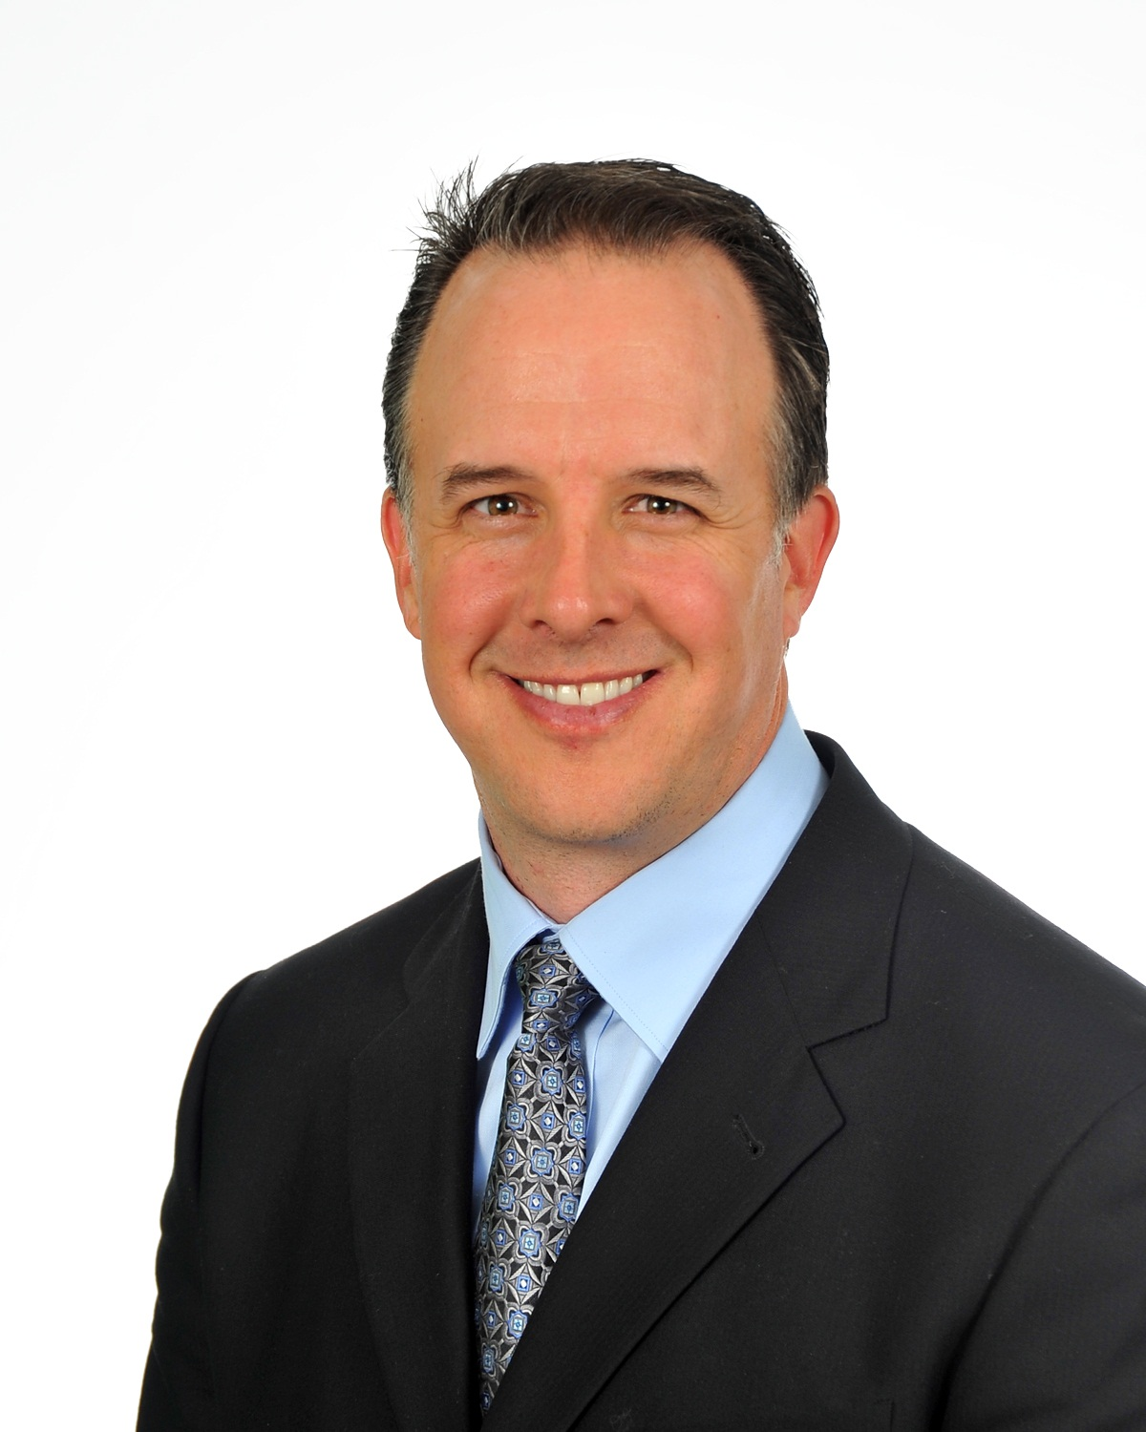
Corporate Seat Replacements
Kevin Chase, Energy Future Holdings, replacing Cheryl Stevens.
Kevin’s term will end December, 2017
Kevin Chase
Chief Information Officer
& Chief Procurement Officer
Senior Vice President
of IT & Supply Chain
Confidential

Slide 4
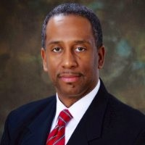
Corporate Seat Replacements
John Munson, Macy’s, replacing Howard Thompson
John’s term will end December, 2015
John Munson Jr.
Vice President, Supplier Diversity
Confidential

Slide 5
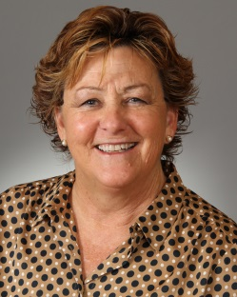
Corporate Seat Replacements
Paula Gibson, Chevron, replacing Betsy Hosick
Paula’s term will end December, 2017
Paula Gibson
General Manager,
Strategic Capability
Confidential

