Slide 1
Nominating Committee
March, 2016 Board Meeting
Confidential

Slide 2
General Information
There are currently 3 Corporate Board vacancies:
    Ford Motor Company
    JPMorgan Chase
    Office Depot/Office Max
Confidential

Slide 3

Corporate Seat Replacement – William R. Kapfer
    Corporation: JPMorgan Chase & Company
    (Term ending December, 2018)
Provides oversight of JPMorgan Chase’s Global Supplier Diversity program
Previous positions include VP of LGBT Marketing, for a NY based Marketing Firm
Marketing background - several major magazines and film companies
William R. Kapfer, PhD
Executive Director,
Global Supplier Diversity
Confidential

Slide 4
Treasurer’s Report to
Board of Directors
March 22, 2016

Slide 5
Agenda
  2015 Unaudited Financial Results (Unrestricted)
  Update 2016 Progress

Slide 6
Executive Summary - 2015
  2015 Unaudited Financial Results (Unrestricted)
    Revenue $10.3M
      4% increase over 2014
    Expenses $10.1M
      5% increase over 2014
    Net Income $176k
  2015 Net Income $176k – outperformed 2015 Forecast by $61k and break-even budget by $173k
  Based upon 2015 Unaudited Financials Results, we anticipate to build Unrestricted Net Assets to $2.4M
Notes:
Highlights:
-2015 Performance ended with a net income of $176,000
Note: These are preliminary, unaudited results and are subject to change to reflect any necessary corrections or adjustments that are identified before or during our audit.
(2015 Audit slide on deck)
-For 2015 Board approved a break-even budget
-2015 Performance surpassed forecast by $61,000 and break-even budget by $173,000
-Strong performances were largely attributed to our Revenue Drivers: Membership, S&S and NCBF
-We continue to exercise sound financial discipline, as a result, we are expecting to add approximately $176,000 into the net assets of the organization as an operating surplus (UNA slide on deck)

Slide 7
2015 Unaudited Financial Results
Revenue, Expenses and Net Income

Slide 8
2015 Unaudited Financial Progress cont’d
  Balance Sheet as of December 31, 2015
    Cash - $4.1M
    Net Liquid Current Assets - $4.8M (Cash + Accounts Receivable – Accounts Payable/Accrued Expenses)
      $531k improvement over 12/31/14
    Net Working Capital - $2M (Current Assets – Current Liabilities)
      $278k improvement over 12/31/14
    Accounts Receivable - $1.4M
      $277k lower than 12/31/14
Notes:
Strong Healthy Balance Sheet – Positive Liquidity
-Year-over-year our cash position continues to improve from our operating activities.
-We continue to take advantage of ACH opportunities to receive payments electronically resulting in faster payments.
-Investment Sub-Committee is focusing on diversifying our existing banking partnership and exploring investment options for excess cash
-Slide on deck to update Board on the Investment Sub-Committee

Slide 9
2015 UNA Reserve Projection
  Targeted UNA Goals
    6 months of UNA Balance is $3.7M
    Achieve goal in ~ 5 years (2019)
  Based upon 2015 Unaudited Financials UNA – $2.4M
    Assumes net income of $176,000
    Approximately 66% of plan goal or ~3.9 months of coverage

Slide 10
Executive Summary – 2016
  2016 Financial Expectations
    Budgeted revenue of $10,632,000 in 2016, representing a 3% increase vs. 2015 actual (unaudited)
    Expenses budget of $10,450,000 representing a 3% increase vs. 2015 actual (unaudited)
    Budgeted Net Income of $182k will contribute to improving the Council’s UNA reserve to $2.6M or ~4.2 months coverage

Slide 11
2016 Overview
Revenue, Expenses and Net Income
Notes:
-Recap on 2016: 2016 Budget aligned to 2015 Actual (unaudited)

Slide 12
2016 Progress
  Membership
    Achieved 96% of $4M goal as of 2/23/2016
  Summit & Salute
    $902k Sponsorship Revenue – surpassing our budget by $52k
  NCBF
    Received over $2M in sponsorship pledges - approximately 79% of budget goal
Notes:
More detail information is available in the Board Book
Membership
-Continue to close the gap, as of March 10, have reached 97% of Revenue Goal ($3,882,250)
-Added 18 new members in Q1
Summit & Salute
As of March 10, Sponsorship Revenue increased $6,000, to $958,000 and surpassing our budget by $58,000
Online Registration closed on March 15 with 1,434 registered attendees, just 20 attendees short of last year this time (forecasting to close this gap with onsite registrations)
NCBF
-Our BD Team continues to close sponsorship opportunities everyday
-As of March 16, we have sold 87% in Sponsorship Revenue – approximately $2,218,500
Registration opened Feb 18, we have 592 registrations (Early bird registration closes April 1)
Expenses
-No concerns, tracking to budget

Slide 13
2016 Summit & Salute
Revenue, Expenses and Net Income
Notes:
Trending to our AOP

Slide 14
2016 NCBF
Revenue, Expenses and Net Income
Notes:
Trending to our AOP

Slide 15
2016 Financial Progress cont’d
  Balance Sheet as of January 31, 2016
    Cash - $4.5M
    Net Liquid Current Assets - $5.7M (Cash + Accounts Receivable – Accounts Payable/Accrued Expenses)
      $455k improvement over 1/31/15
    Net Working Capital - $5.6M (Current Assets – Current Liabilities)
      $389k improvement over 1/31/15
    Accounts Receivable - $1.8M
      $396k lower than 1/31/15
Notes:
Strong Healthy Balance Sheet – Positive Liquidity

Slide 16
Other Activities
  Investment Sub-Committee
    To focus on diversifying our existing banking partnership and to explore investment options for excess cash
  2015 Audit
    Fieldwork to begin April 18
    Goal to have audit draft in June
  Engaging with Corporate Membership and Revenue Generation Committee on Long Range Planning
Notes:
Investment Sub-Committee Steps Taken:
- Completed a Cash Flow Analysis to determine how much working capital is necessary to meet ongoing operating expenses
-Identified approximately $1.5 - $2.0 Million of unrestricted cash funds available for investment
-Looking for recommendations and banking partner relationships that will provide a safe, secure and efficient place to deposit our funds,
with the goal of principal preservation and optimization of cash
-Submitted RFI to 4 Corporate Members
Bank of America (Submitted RFI)
Wells Fargo
JP Morgan Chase
Citi
-Resent email – Extended deadline to March 25

Slide 17
Questions?
Thank You

Slide 18
Digitization Overview
WBENC Board of Directors
March 2016

Slide 19

Milestones and Timeline: Off to the races!
Deliverable | Notes | Timing
WBENCLink stability assessment | System stabilization is imperative prior to project initiation | January 2013- January 2014 (COMPLETE)
2. Analysis of certifying entities currently utilizing a digitized process | Government and 3rd party certifiers included in analysis | March 2014 (COMPLETE)
3. Analysis of required application documentation | Comparison of other certifying entities included in analysis | March 2014 (COMPLETE)
4. Enhancement and implementation of Recertification process improvements | Six month pilot conducted, post analysis conducted and full implementation completed | October 2013-April 2014 (COMPLETE)
5. Technology & digitization options discovery (i.e.: best tools, network impact analysis, etc.) Tool discovery: Pitney Bowes Tool discovery & network impact: Logistics Solutions | Evaluations and discovery sessions relevant to both approaches; bolt-on and total system conversion | November 2014 (COMPLETE) b. October 2013-November 2014 (COMPLETE)

Slide 20

Milestones and Timeline: Pacing…
Complete initial process mapping for current landscape WBENC mapping RPO Input NCC | Current process consensus amongst WBENC and RPOs is essential to new integration discussions and work | February 2015 (COMPLETE) March 2015 (COMPLETE) March 2015 (COMPLETE)
2. Apply high level process mapping to all RPOs and obtained 6 Hat input from the RPOs relevant to the new system. | Provided the WBENC mapping to the RPOs for analysis of each RPO business process to identify gaps and trends | April –June 2015 (COMPLETE)
3. Conduct initial RFI | Conducted a search and identified 3 potential suppliers amongst WBENC network firms and 1 Microsoft referral: B2GNow- regional corporate member ConnXus- national corporate member Logistics Solutions, Inc.- MBE firm Prism- WBE firm | April- July 2015 (COMPLETE)
4, Synthesize all RPO mapping and 6 Hat input |  | July 2015 (COMPLETE)

Slide 21
Milestones and Timeline: Rounding the corner…
Participated in system demo as a result of RFI responses | Of the 4 potential suppliers, demos were conducted by 2: B2GNow ConnXus | July-September 2015 (COMPLETE)
2. Conducted demo of WBENCLink for potential supplier | As a result of the demos, WBENC conducted a demo of WBENCLink for one potential supplier: B2GNow | September 2015 (COMPLETE)
3. Document process mapping and work flow for transitioning to the new WBENCLink | Evaluation of potential new system and WBENC needs to develop enhanced system & process improvements | October – November 2015 (COMPLETE)
4. Finalize selection process | As a result of comprehensive evaluation a supplier was selected B2GNow | January – February 2016 (COMPLETE)

Slide 22

Milestones and Timeline: Home stretch…
GO LIVE DATE: July 15, 2016
Complete analysis of WBENC WBE application questions | Application data is relevant information is collected for WBENC Standards and sourcing | January- February 2016 (COMPLETE)
2. Complete SOW and obtain all appropriate legal documentation |  | January -February 2016
3. Complete implementation plan for transitioning | The kick-off meeting and ongoing transition meetings being held weekly | February 2016 and ongoing
4. Meet with CVM to discuss 2016 services and data migration requirements | Collaboration with the current supplier for data migration to the new supplier is critical for a successful project | January – March 2016

Slide 23

Next Steps: Finish line in sight…
Deliverable | Notes | Timing
Meet with CVM and B2G regarding data migration plan | Collaboration and key understandings regarding the data is critical to the success of the project | March 2016
2. Leadership Council | Review of all project elements and ongoing through project completion | March – July 2016
3. RPO Certification Team Training | Robust process training is essential to the success of the implementation | March- June 2016
4. Coordinate RPO Certification Team and WBENC Certification Department attendance at B2GNow User Conference | B2G holds an annual User Conference and due to the July implementation they will provide a WBENC specific track during the conference | May 2-6, 2016
5. Complete Communication Plan | The communication plan is a living document which is updated as the project is completed Priority given to WBEs whose applications will be due during July 2016 implementation | February and ongoing
6. Identify Testing Teams | As historically done, WBENC will identify Testing Teams who represent all constituents | April 2016

Slide 24
B2GNow User Conference: May 2-5, 2016

Slide 25
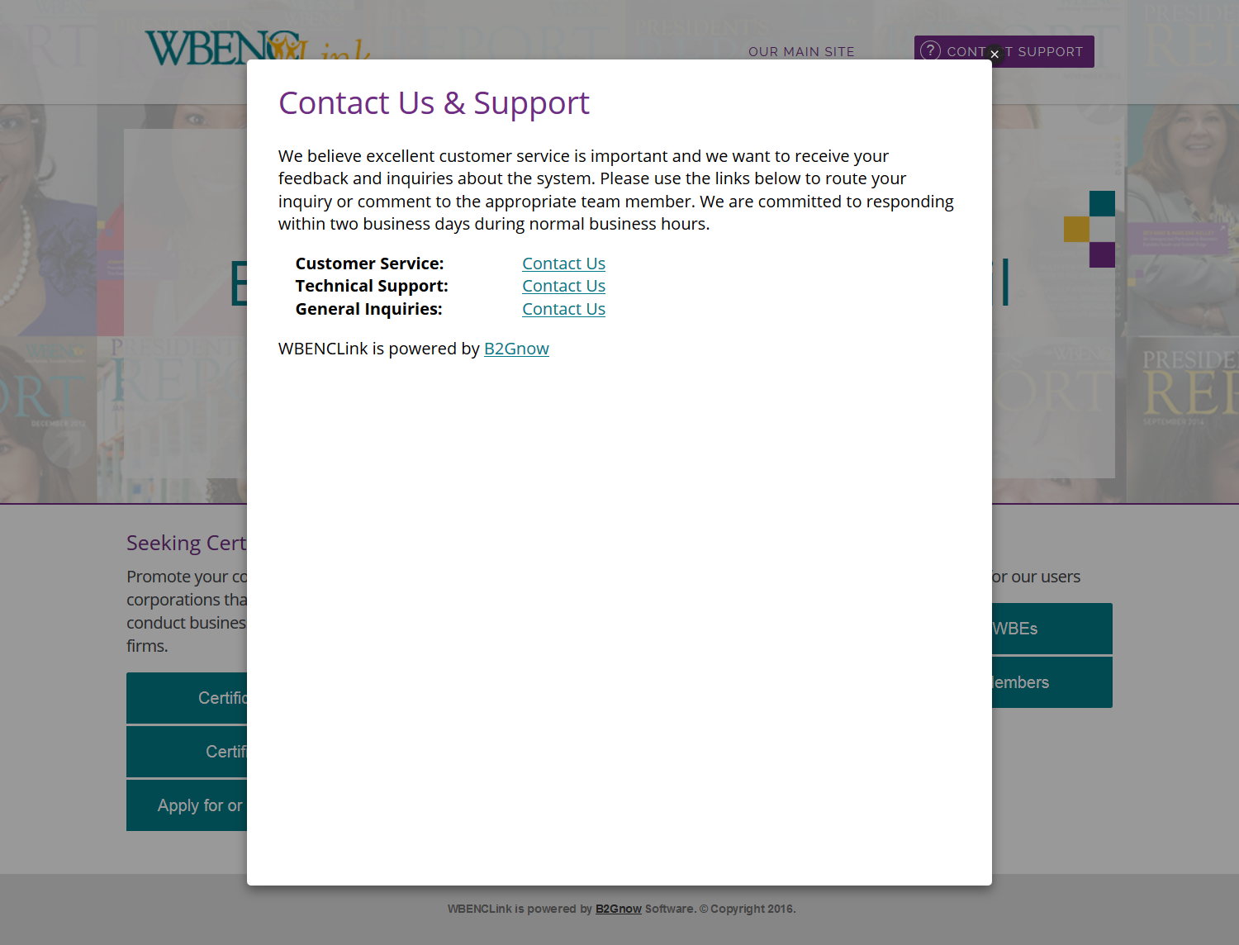
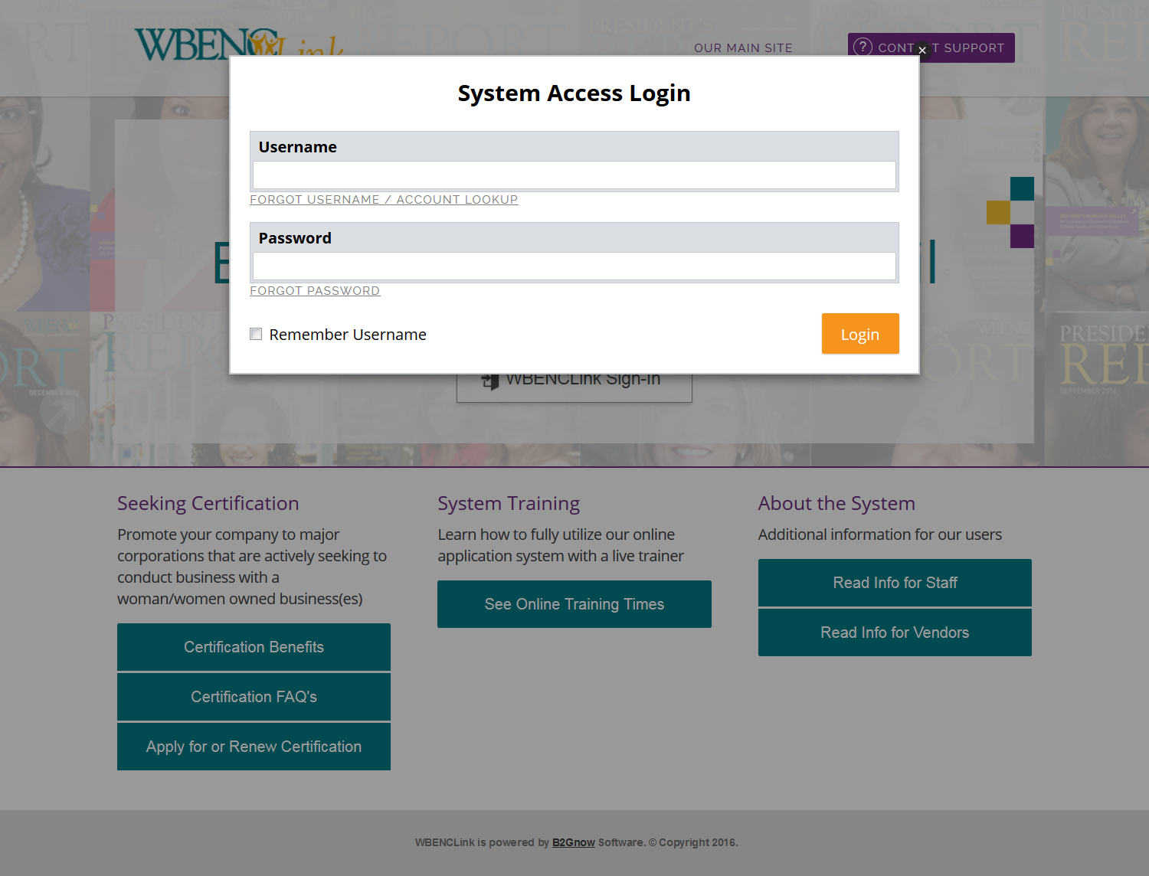
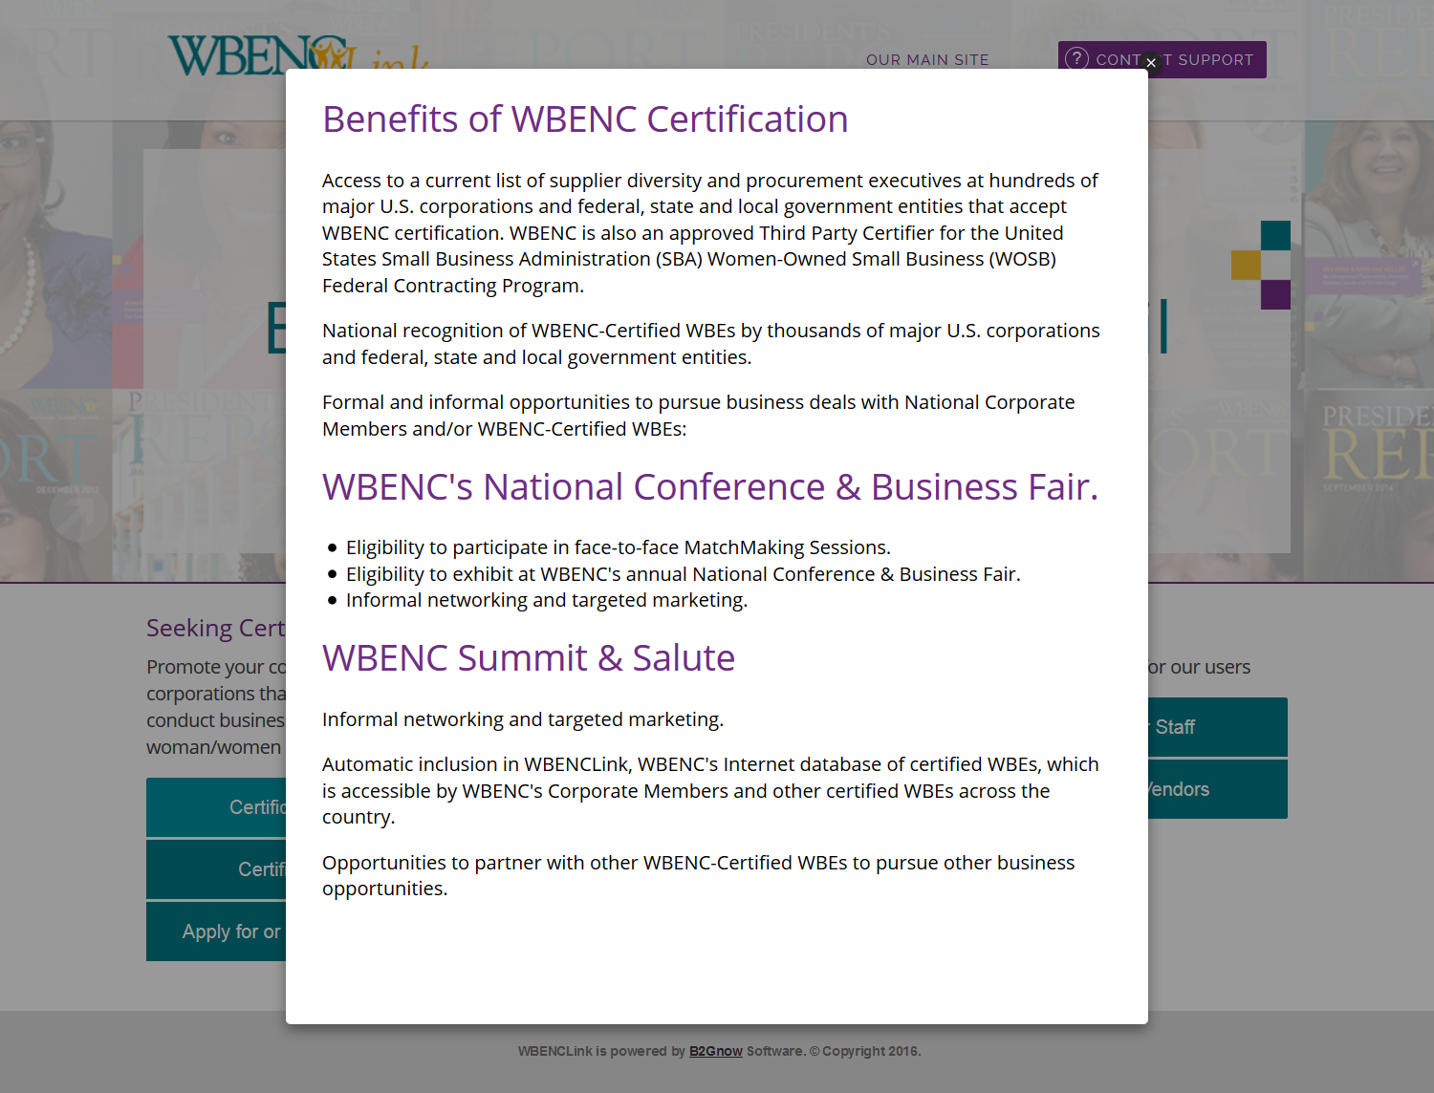
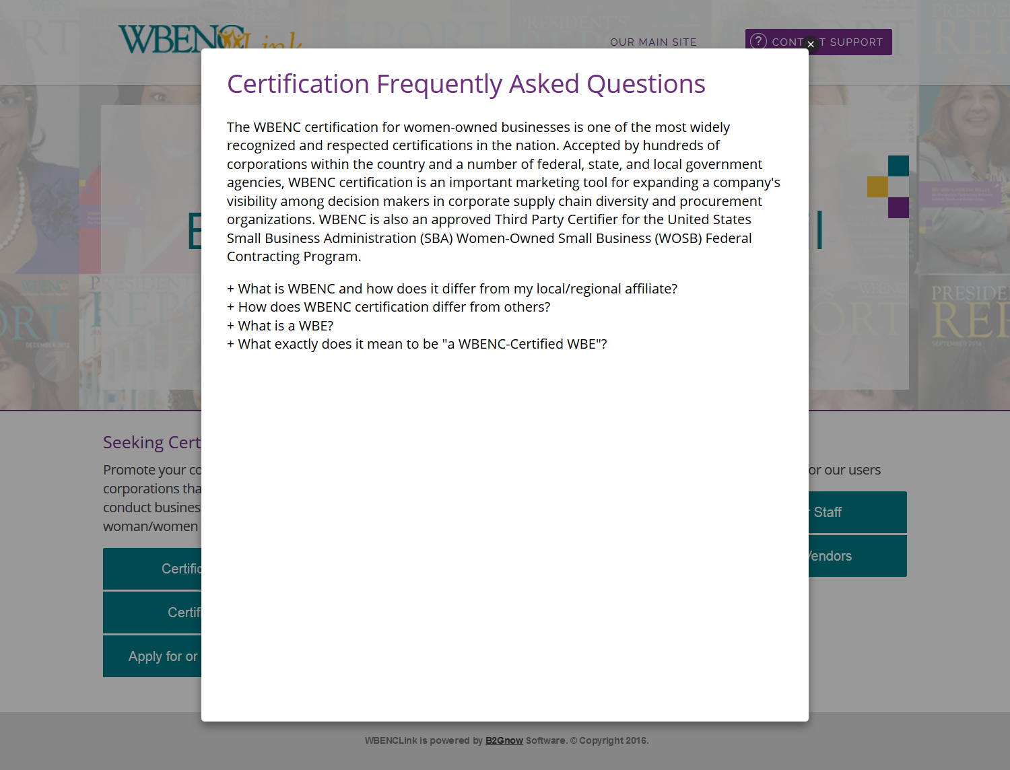
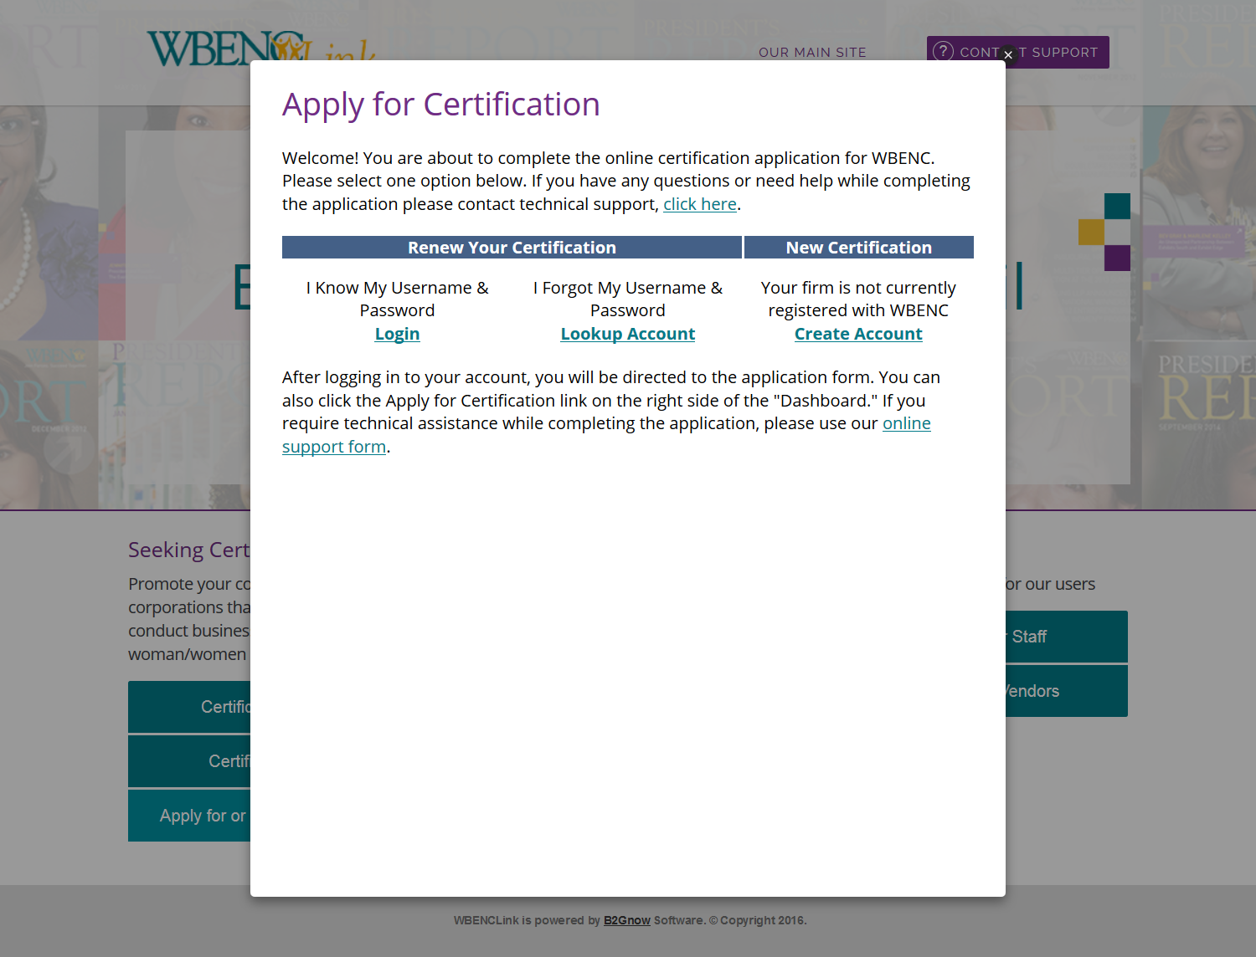
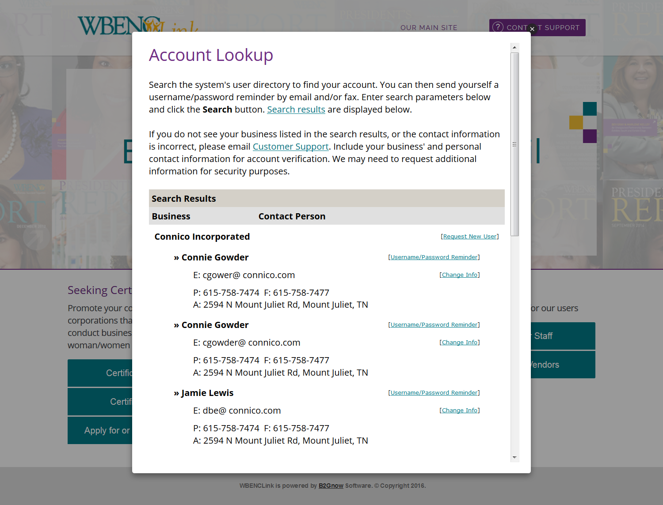
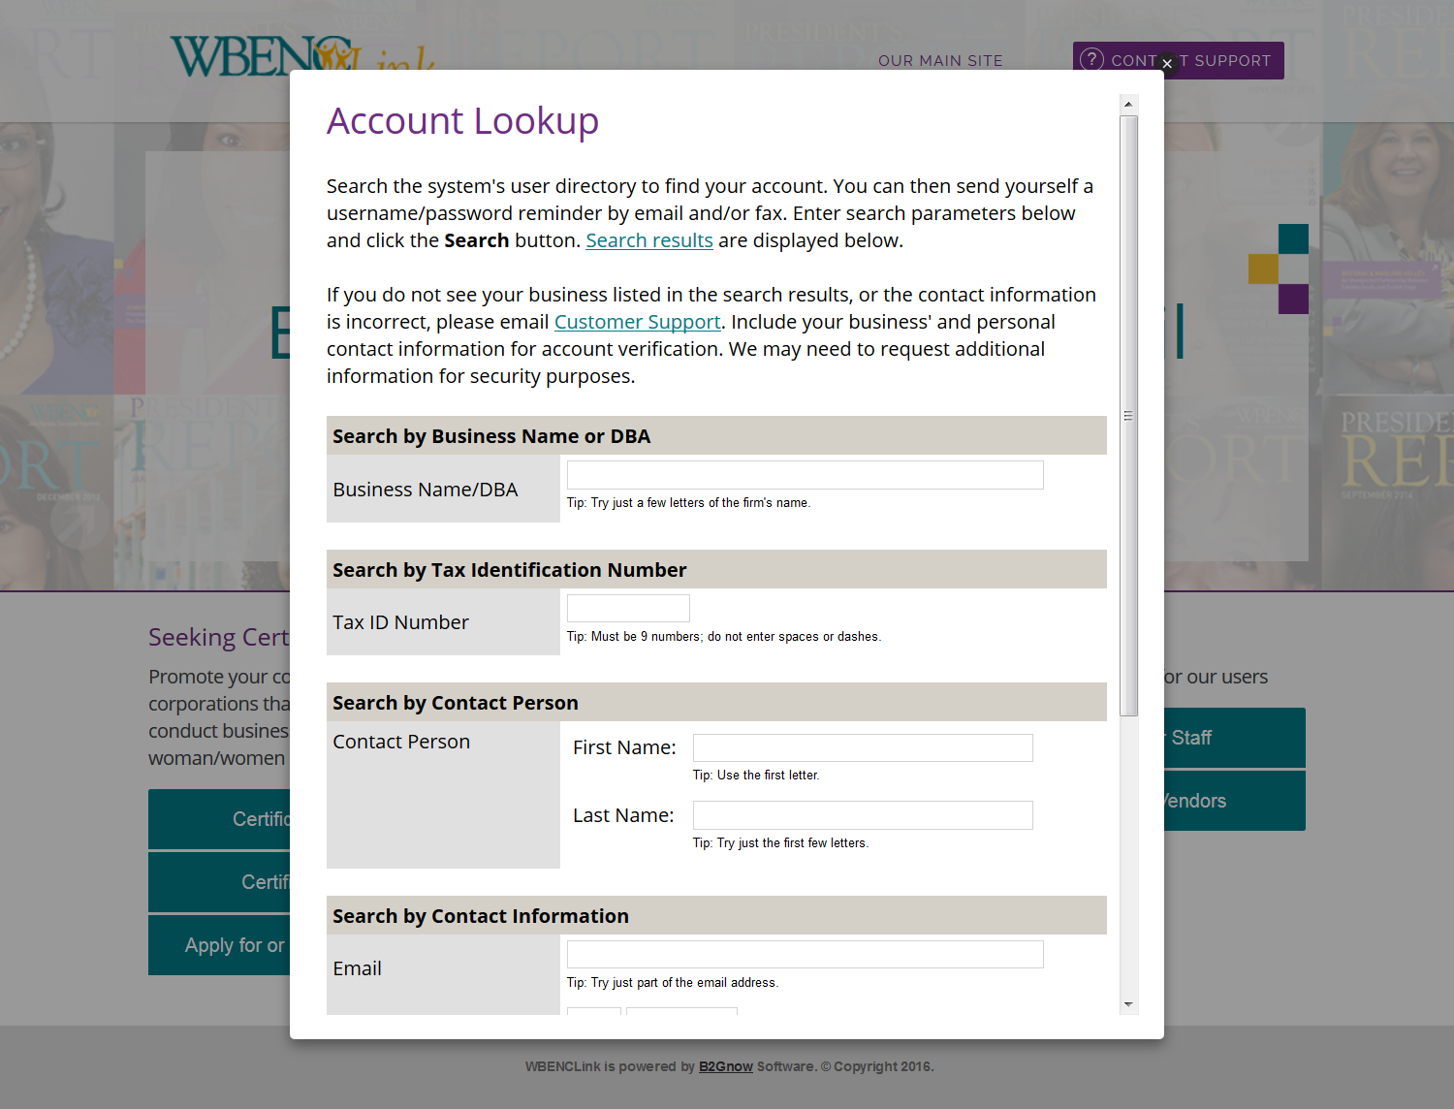
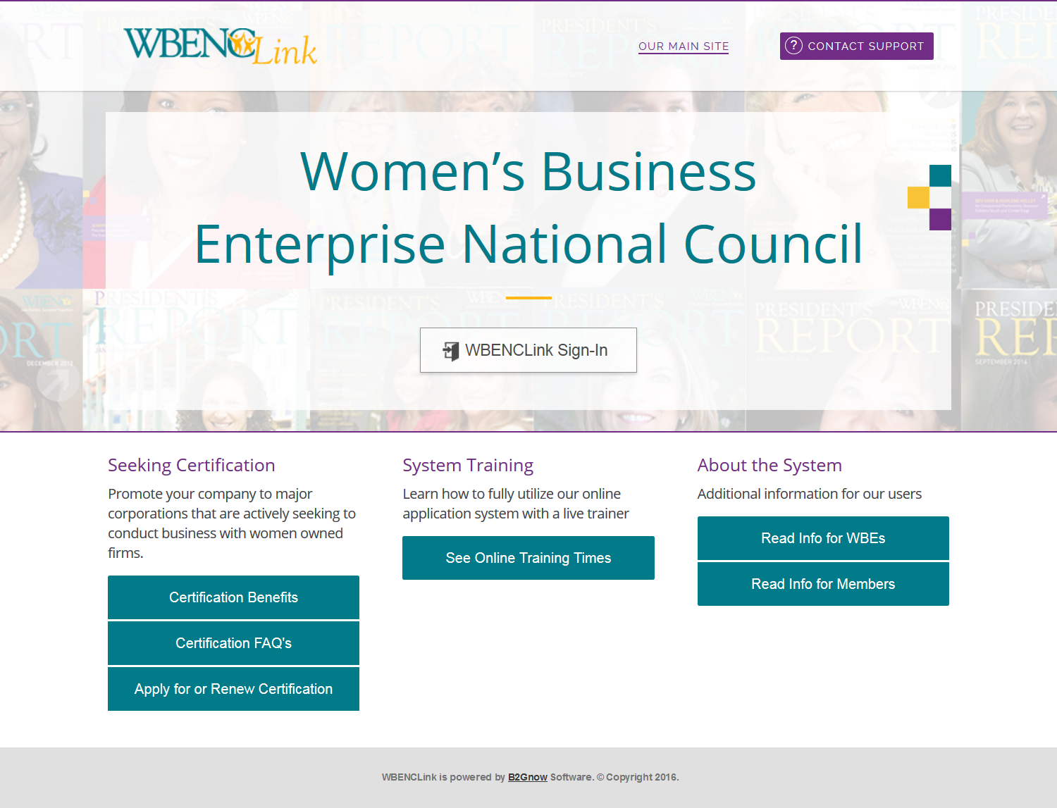
Accessing WBENCLink

Slide 26
Thank you for your time and consideration

Slide 27
Corporate Membership & Revenue Generation Committee
Revenue Generation Sub-Committee Update
Board of Directors Meeting
March 22, 2016

Slide 28
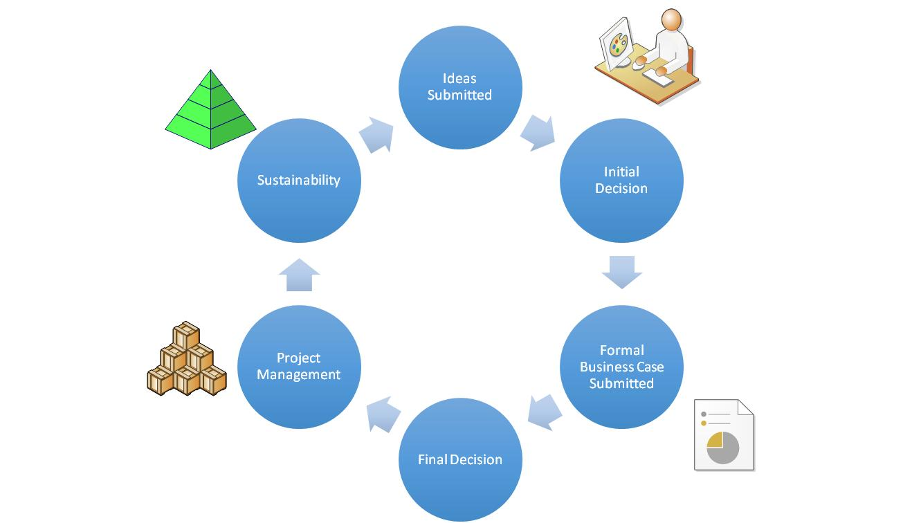
Executive Summary
Objective: Build a 3-5 year long range plan/model for WBENC that provides visibility into the ROI on current revenue streams and insight into future programs/initiatives that require alternate funding mechanisms
Formal process required to capture information to build and sustain the WBENC long range plan
  Develop and implement intake process for preliminary approval/routing of new ideas
  Develop planning and resource allocation process including business case and decision matrix to facilitate final go/no-go decision
  Baseline current revenue streams and programs/initiatives requiring monetary and/or human capital
  Build scorecard to monitor in-year activities and long-range plan outlining future objectives/requirements

Slide 29
Progress Report
Task | Target Completion Date
Develop and implement intake process for preliminary approval/routing of new ideas High level process map – 100% complete Intake form and pre-approval process – 90% complete | 4/30/16
Develop planning and resource allocation process including business case and decision matrix to facilitate final go/no-go decision Business case template and submission process – 85% complete | 4/30/16
Baseline current revenue streams and programs/initiatives requiring monetary and/or human capital Identify current revenue streams – 75% complete Identify programs/initiatives (monetary/human capital required) – 10% complete | 5/31/16
Build scorecard to monitor in-year activities Not started | 5/31/16
Build long-range plan outlining future objectives/requirements Not started | 6/30/16

