Slide 1
Wbenc board of directors
june 2018 board meeting
COBO Center
Detroit, MI

Slide 2
Nominating committee report
June 2018 Board Meeting

Slide 3
June Board elections
Nominating committee
Corporate Nominations for Existing Board Seats (2):
Casey Oakes, Marriott International
Anuradha Hebbar, Verizon
Leadership Council Nominations for Board Seats (2):
Nancy Allen, WBDC-Florida
Sheila Mixon, ORV-WBC
Current Open Corporate Board Seats (2):
Motorola Solutions
Verizon
Current Vacant Board Seats (2):
1 WBE Seat
1 Additional WBE Seat
*due to increase in corporate seats-Nov 2017

Slide 4
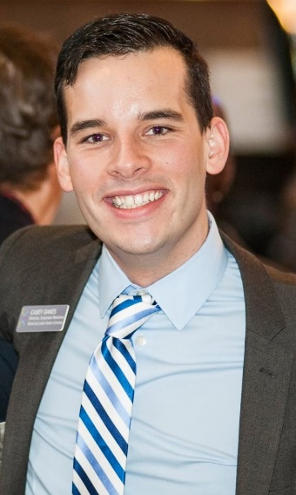
CASEY OAKES director, supplier diversity MARRIOTT INTERNATIONAL
Corporate nominations
Casey Oakes joined Marriott as Director of Supplier Diversity in March 2018 where he is overseeing the company’s effort to reach 1 billion in spend annually with diverse-owned companies by 2020. Before joining Marriott, Casey worked at NGLCC: The National LGBT Chamber of Commerce where he served as Vice President, Corporate Relations. In this role, Casey served as the organization’s principle liaison to corporate America providing consult and support to nearly 200 corporate supplier diversity programs while helping to steer organization strategy and long-term planning.

Slide 5
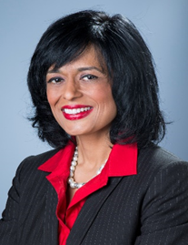
ANURADHA HEBBAR GLOBAL HEAD OF DIVERSITY & INCLUSION VERIZON
Corporate nominations
As the Global Head of Diversity and Inclusion at Verizon, a Fortune #14 company with $126 billion dollars in revenue and over 160,000 employees, Anuradha is responsible for the company’s strategic direction around diversity and inclusion. She has also held Chief Diversity Officer roles at Zurich North America, Health Care Service Corporation, and was the Director of Strategic Diversity and Inclusion at McDonald’s Corporation. Prior to that, Anuradha was a seasoned consultant advising Fortune 500 C-Suite teams on their human capital and diversity and inclusion initiatives. Anuradha’s clients have included Grainger, Molex, Northshore University Health Systems, The Leo Burnett Company, Wrigley, Interpublic, Johnson and Johnson, and PepsiCo.

Slide 6
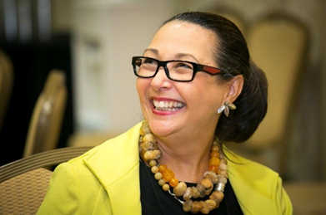
NANCY ALLEN president & ceo women’s business development council - florida
LEADERSHIP COUNCIL nominations
Nancy Allen is an international speaker, coach, consultant and expert on women’s business issues. Nancy has over 30 years of experience helping small business owners at all stages of growth. As President and CEO of WBDC Florida/Her Company Incorporated, Nancy manages and leads an incredible team of staff, sponsors, partners and women business leaders who are dedicated to certifying, connecting and championing women in business.

Slide 7
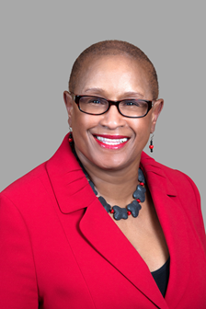
SHEILA MIXON president & ceo ohio river valley women’s business council
LEADERSHIP COUNCIL nominations
As Executive Director of ORV~WBC, Sheila Mixon manages the day to day operations of the certification process and program development. Provide vision, leadership, organizational governance and strategic direction for corporate members and almost 1,000 WBE's is the states of OH, KY and WV. To add value for the WBENC Certification, Ms. Mixon created and launched The Ohio River Valley Business Development Program for select high growth WBE's in January 2015 which is based on the Kauffman Foundation's FastTrac Growth Venture Program. Under her leadership, there has been an increase in corporate members, certified WBE's and procurement opportunities.

Slide 8
Update: 2018 corporate re-nominations
2017 Pilot for Revised Scorecard
2018 Continued Revisions Based on 2017 Process & Feedback
Outreach to 2018 expiring seats by mid-July
Those in board seats less than 1 year are not reviewed

Slide 9
TREASURER’S REPORT
Nancy Creuziger
June 18, 2018

Slide 10
Presentation Topics
Financials
YTD May 2018 Financial Results
Summit & Salute Financial Performance
National Conference & Business Fair Progress
Status of 2017 Audit
Investment Update
2019 Budget Development Schedule

Slide 11
YTD May 2018 FINANCIAL RESULTS
financials
As of May 31, 2018:
Revenue: WBENC has reached $10.8mm, which is 85% of the budgeted amount of $12.7mm (at 5/31/17, 93% of the total 2017 revenue budget had been achieved)
Expenses: $4.4mm, which is 35% of the budgeted amount of $12.7mm
Change in Net Assets (Net Income): $6.5mm (This will be greatly reduced as the year goes on; WBENC still expects the budgeted net income.)
Notes:
Notes:
WBENC generates most of its revenue during the first 6 months of the year. There are some remaining membership dues, NCBF sponsorships / registration fees, and other programs revenue, e.g. Tuck, to be recognized in the coming months.
2018 revenue is slightly behind last year this time. This is due to last year stretch goal for the 20th Anniversary Celebration.
We are on track to meet our expected year-end outcome.
Expenses appear low now, however, in the next two months after the conclusion of NCBF, we will record conference-related costs.

Slide 12
YTD May 2018 FINANCIAL RESULTS
Financials
Notes:
Notes:
This is a graph of the previous slide.

Slide 13
YTD May 2018 FINANCIAL RESULTS
financials
Balance Sheet as of May 31, 2018
Cash - $7.8mm ($7.7mm at 5/31/17)
Accounts Receivable, net - $1.5mm ($1.4mm at 5/31/17)
Net Liquid Current Assets – $9.1mm at 5/31/18 versus $8.5mm at 5/31/17 (Cash + Accounts Receivable – Accounts Payable and Accrued Expenses)
Net Working Capital - $9.1mm at 5/31/18 versus $8.3mm at 5/31/17 (Current Assets – Current Liabilities)
Notes:
Notes:
Our liquidity position remains strong. Cash is slightly ahead of last year.
Accounts receivable is slightly higher than last year. There are no concerns.
Our financial ratios continue to improve as our cash balance grows.

Slide 14
2018 Summit & salute FINANCIAL performance
Financials
Notes:
Notes:
Revenue: We are on track to exceed our Summit & Salute revenue budget. For sponsorship, we have an additional $65,000 to record in July (due to sponsor’s request to be bill in the month aligned with their fiscal year). Registration fees exceeded budget by $128,000 or 32%.
Record breaking attendance hosted 1,713 attendees in Dallas

Slide 15
2018 National Conference & Business Fair Progress
Financials
Notes:
Notes:
Revenue: An additional $150,000 of revenue will be recognized in the June financial, in addition, will record onsite registration fees and silent auction.
Online conference registration closed on June 11th.
Expenses: The majority of the conference-related invoices will be received in June and July. Therefore, expenses appear low now.

Slide 16
2018 membership Progress
financials
Revenue: Achieved 96% of $4.5mm budgeted goal (updated 5/21/18)
16 new members as of 5/21/18

Slide 17
Update on other items
financials
Audit: Field work for the 2017 audit was completed in April 2018. The auditors are reviewing the audit file and expect to have a draft to WBENC Management in July.
Investment: In April 2018, WBENC opened an interest-bearing account and transferred $2.0mm.

Slide 18
2019 budget Development schedule
financials
Budget development will occur in July and August
A forecast will be completed as part of this process
Propose to Finance Committee in September
Propose to Extended Executive Committee in October
Recommend to Board and vote on at the November meeting

Slide 19
questions?
Thank You

Slide 20
Strategic plan
WBENC NETWORK Update
Laura Taylor, Vice President Partner Network Planning and Operations
June 18, 2018

Slide 21
Mission, goals & Three part approach
To fuel economic growth globally through access to opportunities by identifying, certifying, and facilitating development of women-owned businesses
1. GROWTH - Deliver a network model which positions WBENC and its partners for scalable and sustainable growth
2. GOVERNANCE - Deliver a relationship model which provides clarity of responsibilities and outcomes
3. CORE - Create a design that ensures WBENC and its network delivers to our CORE value proposition, is aligned with our mission of furthering women’s business development and leverages the WBENC brand
MISSION & GOALS
2

Slide 22
Progress
GOALS
GROWTH
Evaluate membership and dues structure and recommend alternative models in support of growth objectives
Conduct a WBENC brand evaluation
GOVERNANCE
Create a WBENC Network CORE Requirements and Operating Manual
Create a new Service Agreement based on inclusion of Network and CORE requirements from the new Operating Manual
Define the process and governance for managing growth opportunities across the network
CORE
Define Programs and Services aligned with CORE value proposition and strategic plan goals
Establish standards for content and delivery of programs
Develop and implement CORE elements in phases
PROGRESS
GROWTH
Completed a membership model baseline
Received strong feedback to maintain current model
Identified opportunities to strengthen brand recognition and to connect our brand across the network
Decision in late 2017 to proceed with national brand update, RPO’s given the option to participate
GOVERNANCE
Implemented WBENC Network CORE Requirements and Operating Manual and new Service Agreement in Q1 2017
Defined basic governance approach to managing growth opportunities across the network
More discussion planned in 2018 on WBENC Network best practices and growth opportunities
CORE
Defined CORE Programs and Services
Establishing standards as programs are implemented
Implemented first CORE element in Q1 2018
More basic programming to come in 2018/2019
JUNE 2018 UPDATE
3

Slide 23
Baseline Programming across the network
Program | Timing
Onboarding WBEs | Launched Q1 2018
Doing Business with the Federal Government | Piloted Q1 2018
Getting Certified | Draft Q3 2018
Developing Your Business Plan | Draft Q3 2018
Onboarding Corporate Partners | Draft Q4 2018
Understanding the Corporate Scorecard | 2019
The Supplier Diversity Proposition | 2019
CORE ELEMENTS
4
Notes:
The Process
Define Programs and Services aligned with CORE value proposition and strategic plan goals
Establish standards for content and delivery of programs
Develop and implement CORE elements in phases
Learnings from Federal Government pilot program

Slide 24
WBENC & Planet mogul
Board Updates
6/17/2018

Slide 25
Planet mogul overview
The curriculum
Planet Mogul develops the next generation of entrepreneurs, innovators and community leaders by providing an intellectual and interactive learning environment for elementary and middle school students; empowering them to achieve more for themselves, their families and their communities.
Notes:
Middle school/high school

Slide 26
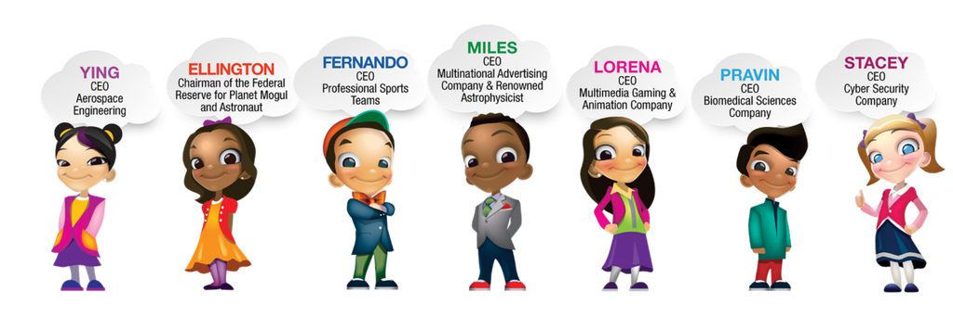
Planet mogul: How
The curriculum
The proprietary Moguls-in-Training Workbook (ages 8-12) features 17 different industries. Each industry section includes the market size (economics), an industry activity (innovation, science, technology, arts) an industry math problem(s) and the opportunity to choose their first Board of Directors (teamwork).
Each industry also includes augmented reality. This digital environment features additional videos, surveys, career guides and can be customized, per partner.
Notes:
17 industries

Slide 27
THE PROGRAM
Our launch
9:00 – 9:30 am: Welcome from WBENC & Sponsors
9:30 – 10:30 am: Session 1: students went to one of three tracks
(Health, Technology/Telecommunications, Automotive)
10:30 – 11:30 am: Session 2
11:30 – 12:30 pm: Lunch & Networking
12:30 – 1:30 pm: Session 3
1:30 – 2:00 pm: Submissions are posted for Voting & Student Reflection
2:00 – 3:00 pm: Winners announced & closing remarks from sponsors
Kickoff Session Today: Cornerstone Schools- Jefferson Douglass Academy

Slide 28
Sponsors
Our sponsors

Slide 29
Wbenc board of directors
june 2018 board meeting
COBO Center
Detroit, MI

